Slide 1
HANGMAN GAME PROJECT
PRESENTED BY :
AKSHAT JOSHI (19124006)
AKSHIT DUGGAL (19124007)
ARYAN GARG (19124018)

Slide 2

HANGMAN GAME
AGENDA OF THE DAY:
Description Of The Game
Rules Of The Game
Use Of Graphics And Sounds In The Game
Use Of Classes And Objects With Functions
Use Of Constructors And Destructors
Use Of Function Overloading & Polymorphism
Use Of Encapsulation
Use Of Inheritance
Use Of Abstraction

Slide 3
MAIN USAGE OF CONCEPTS OF OOPS
04
POLYMORPHISM
INHERITANCE
01
03
ABSTRACTION
ENCAPSULATION
02

Slide 4


PROJECT TIMELINE
10 OCT
15 OCT
30 OCT
5 NOV
10 NOV
16 NOV
FINDING THE GRAPHICS
SETTING UP OF THE GRAPHICS
USING CLASSES
USE OF OTHER OOPS CONCEPTS
COLLABORATION OF THE WORK
PROJECT COMPLETION

Slide 5
DESCRIPTION OF THE GAME
The Hangman Game consists of the guessing of the letters of a word which needs to be guessed.
The word which needs to be guessed is first displayed in the form of dashes that are displayed.
The player guesses the string or the word by each letter . If the string has that letter in it’s collection of the letters of the strings , all the occurrences of that letter are displayed in the string or the word.
But if the user fails to guess the word the user looses the game . Here in the user enters the letter one by one and get’s exactly that no. of tries as the length of the string or the word which needs to be guessed in the game.
Also as a visual , the man gets build up in the picture and it seems that if the user fails to guess the word the man get’s hanged up and dies in the game which is used here in as an animation.

Slide 6

RULES OF THE GAME
Study about the rules of the game by entering inside the rules section of the game.
The Game Could Be Played Individually or in the groups.
Hints will be displayed for the word. Press the letter to complete the word to be guessed. If the letter you typed is right than it will appear in the string of word else the hangman will start to build . Different sounds of right and wrong typed letters will be played . The no. of wins and losses will be shown on the middle page.
If the user guessed it right than he/she will win and loose if all the body parts of hangman are displayed and game continues till the word is guessed fully . Quit the game by clicking quit button. Play again could be clicked to play again the game.

Slide 7

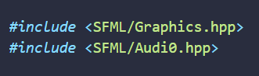
USE OF GRAPHICS IN THE PROJECT
The library we used here for the graphics and the sound system in our project is based on the SFML(Simple and Fast Multimedia Library) . It is a very quick and an easy library we have used.
The use we have made is to draw the body parts of the Hangman , the font style we have used and the sound system we have played during the start of the game and also the events such as winning , losing and when we type the correct or the wrong word.
Also the graphics used inside this library have used the basics of the coordinate system which we have used to display the values or the text with the use of graphical figures and shapes.

Slide 8
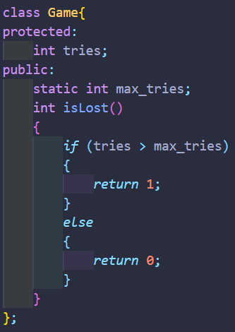
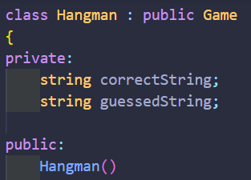
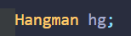
USE OF CLASSES AND THE OBJECTS
The project uses two classes : Game and Hangman.
The class Game has the member tries and member function isLost under Private access specifier.
The class Hangman is another class which is derived from the class game with two private members and various other public member functions that are being used in here inside our project that has been made in it.
The Object that has been used is of the derived class Hangman . This object’s data is used by accessing the member functions that area declared public inside the classes.

Slide 9
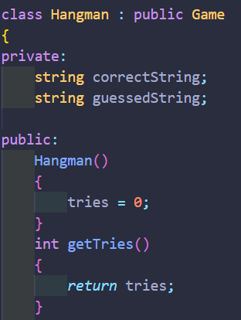
USE OF CONSTRUCTORS AND DESTRUCTORS
This game project makes the use of two classes.
A constructor always has the same name as of the class. Here we have used the Hangman class.
In class-based object-oriented programming, a constructor is a special type of subroutine called to create an object. It prepares the new object for use, often accepting arguments that the constructor uses to set required member variables.
The Constructor here displayed is of the Hangman class which is here the default constructor that initializes the tries variable i . e no. of tries the user can take for finding of the correct sequence of letters or the word that is going to be displayed.

Slide 10
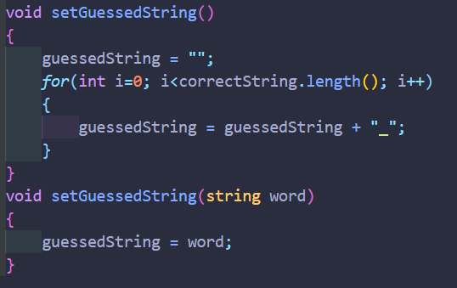
USE OF FUNCTION OVERLOADING AND POLYMORPHISM
Polymorphism is having multiple functions with same name but different parameters then these functions are said to be overloaded. Functions can be overloaded by change in number of arguments or/and change in type of arguments.
Here in our case we have used the function setGuessedString multiple times in the program of the game.
In the First case it is not taking any of the arguments but in the second case when the function has been used , one argument word of the string datatype has been used.
Also this is the compile time polymorphism Which makes the use in the compilation time.

Slide 11
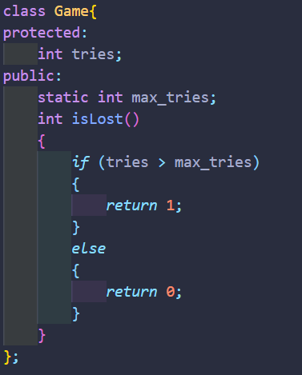
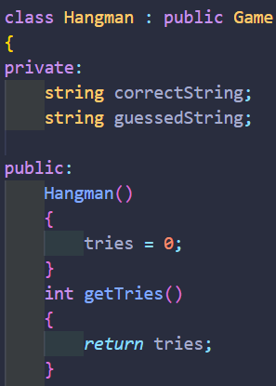
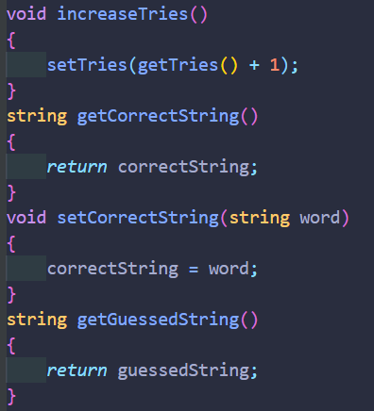
USE OF ENCAPSULATION
Encapsulation is a really important concept of Object Oriented Programming Language.
In normal terms Encapsulation is defined as wrapping up of data and information under a single unit. In Object Oriented Programming, Encapsulation is defined as binding together the data and the functions that manipulates them.
Here in our project we have kept all the member variables and member functions in access specifiers private and public respectively inside our class Game And Hangman and kept all of the data together.

Slide 12
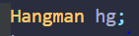
USE OF INHERITANCE
The project uses two classes : Game and Hangman.
The class Game has the member tries and member function isLost under Private access specifier.
The class Hangman inherited or being derived from the class Game . The Access specifier used here is the Public means that all of the public members of base class Game are inherited into class Hangman as public and protected members as protected and the private members could be used by using the public member functions by using the object of derived class as private members are not inherited.
So here the class Hangman get’s the access of some of the members of the base class Game.

Slide 13
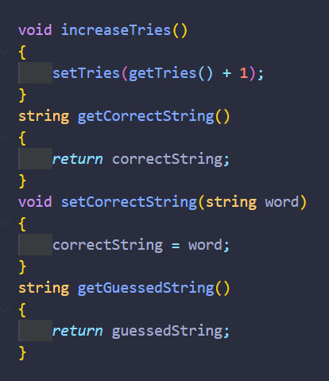
USE OF ABSTRACTION
Abstraction is a really important concept of Object Oriented Programming Language.
Abstraction means displaying only essential information and hiding the details. Data abstraction refers to providing only essential information about the data to the outside world, hiding the background details or implementation. It is implemented in classes using access specifiers public and private.
Here in our project we have kept all the member variables and member functions in access specifiers private and public respectively inside our class Game And Hangman and kept all of the data together.

Slide 14
REFERENCES
https://www.sfml-dev.org/
https://www.iup.edu/teachingexcellence/reflective-practice/past-events/2008-09/sample-games-to-be-used-in-the-classroom/instructions-for-playing-hangman/
https://en.wikipedia.org/wiki/Hangman_(game)
https://www.geeksforgeeks.org/c-plus-plus/
https://www.tutorialspoint.com/cplusplus/cpp_object_oriented.htm

Slide 15
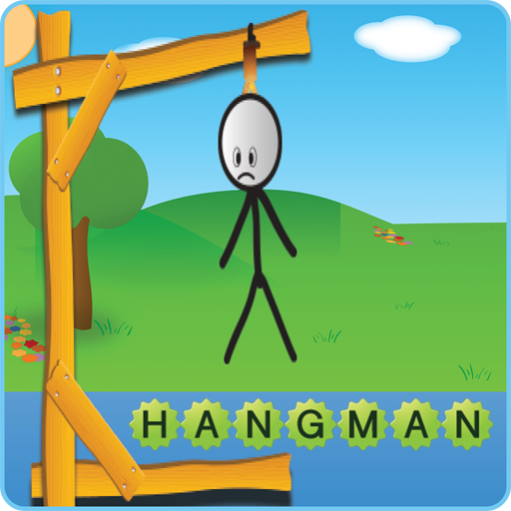
THANK YOU
LET’S PLAY THE GAME

